Slide 1

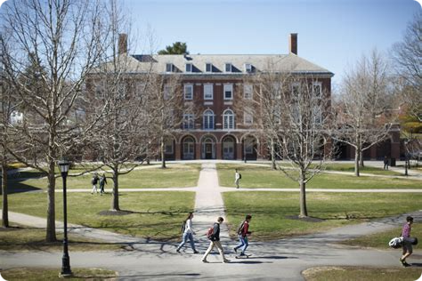
A Home Away from Home: The Residential Experience at École Globale
A Premier International Boarding School for Girls
AS
by Apoorv Srivastava

Slide 2


Introduction to École Globale
Welcome to École Globale International Girls’ School
1
Mission & Vision
Overview of the school’s mission and vision
2
Reputation
Established reputation for academic excellence and holistic development
3
Global Students
Welcoming students from across the globe

Slide 3
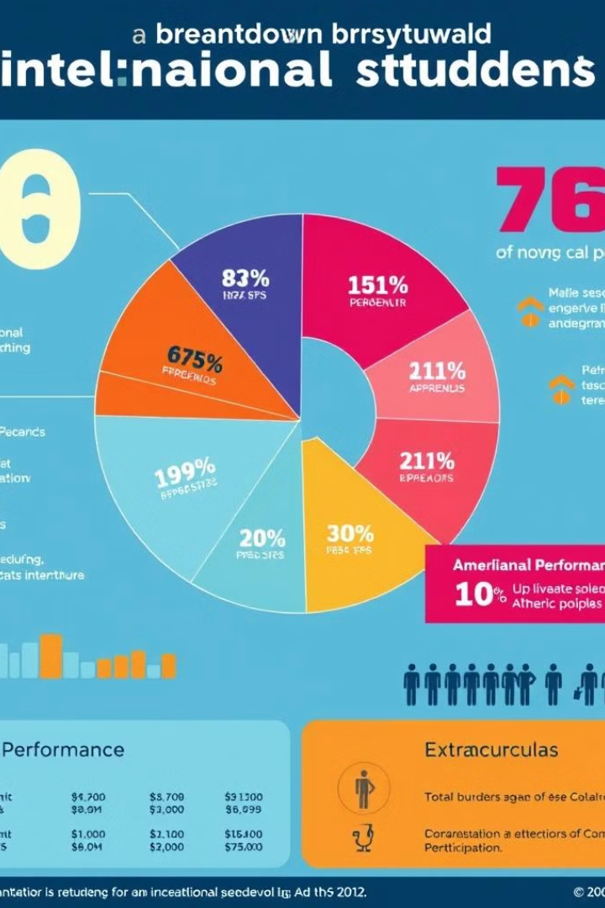
Why Choose École Globale?
Key Reasons to Choose École Globale
Safe Environment
Safe and secure environment
Boarding Facilities
Top-notch boarding facilities
Academics & Extracurriculars
Strong emphasis on academics, sports, and extracurriculars
Cultural Diversity
Cultural diversity and global exposure

Slide 4
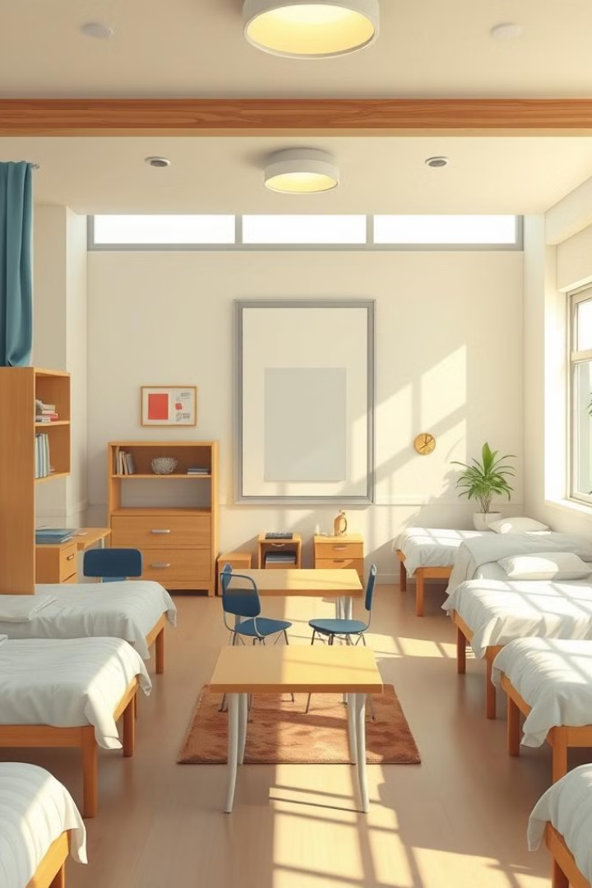
Boarding Facilities Overview
A Safe and Comfortable Place to Call Home
1
Dormitories
Spacious, well-furnished dormitories
2
Meals
Healthy and balanced meals provided
3
Supervision & Support
24/7 supervision and support staff
4
Medical & Wellness
Medical facilities and wellness programs

Slide 5

Daily Life at École Globale
What Does a Typical Day Look Like?
1
Academics & Sports
Balanced routine of academics, sports, and personal time
2
Mentorship
Mentorship and guidance from resident tutors
3
Self-Study & Extracurriculars
Time for self-study and extracurricular involvement

Slide 6
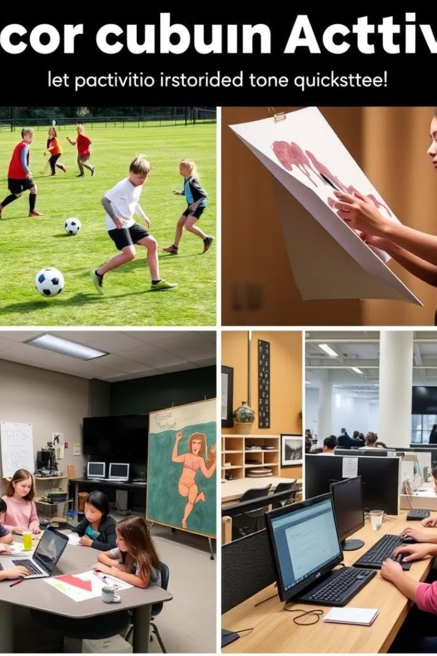
Co-Curricular Activities
Beyond the Classroom
1
Arts & Music
Wide range of activities: arts, music, drama, debate, coding, etc.
2
Sports
Special emphasis on sports: swimming, basketball, tennis, and more
3
Competitions
Participation in national and international competitions

Slide 7
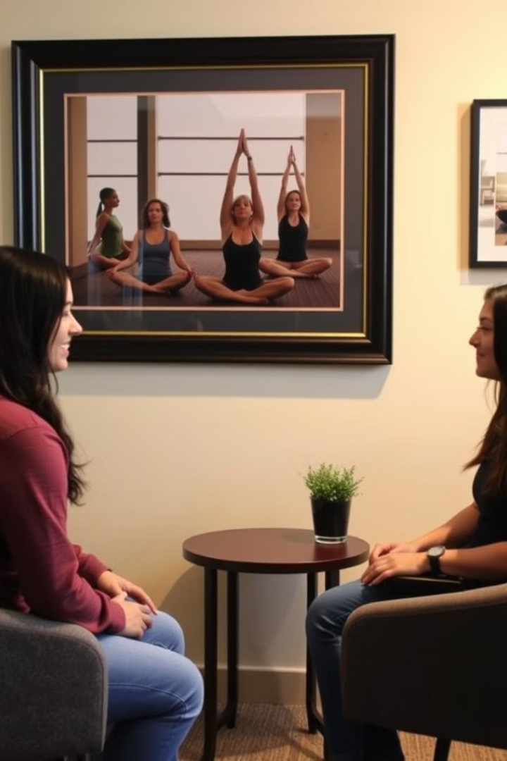
Pastoral Care & Well-being
Ensuring Emotional and Physical Well-being
1
Emotional Support
Resident counselors for emotional support
2
Peer Mentoring
Peer mentoring programs
3
Health & Wellness
Regular health check-ups and wellness sessions

Slide 8

International Exposure
Building Global Citizens
1
Cultural Exposure
Exposure to different cultures through diverse student body
2
Exchange Programs
International exchange programs
3
Global Opportunities
Preparing students for global opportunities

Slide 9
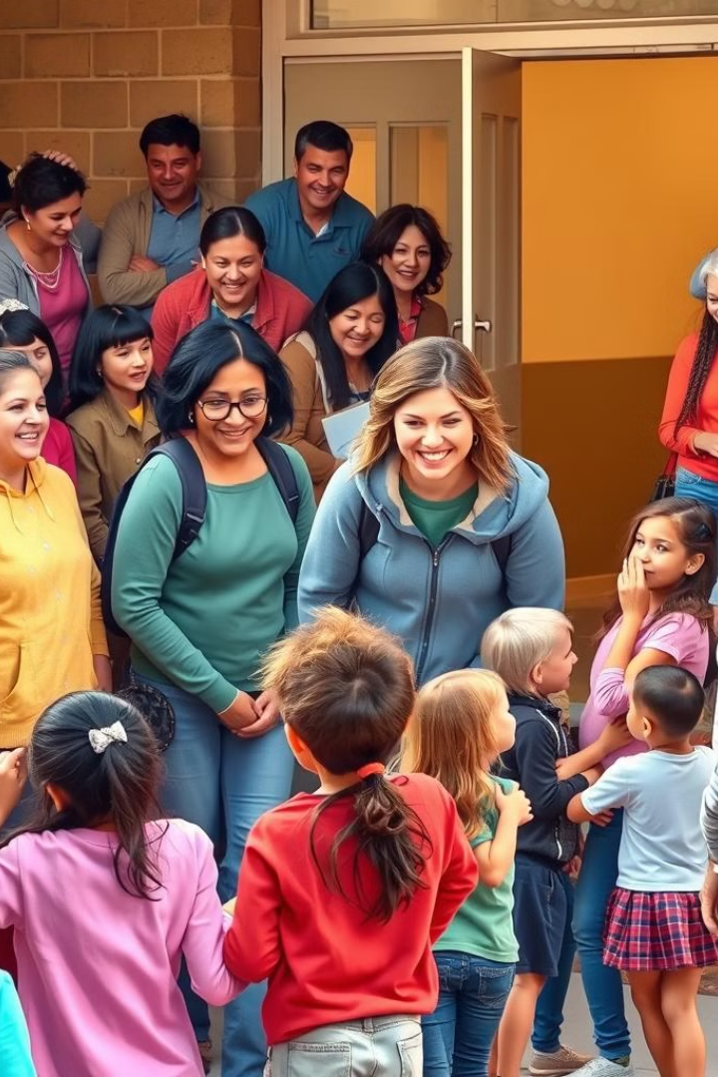
Parent Testimonials
Hear from Our Families
1
Parent Quotes
Testimonials from current parents (brief quotes)
2
Satisfaction
Highlight satisfaction with school’s communication, care, and academics

Slide 10
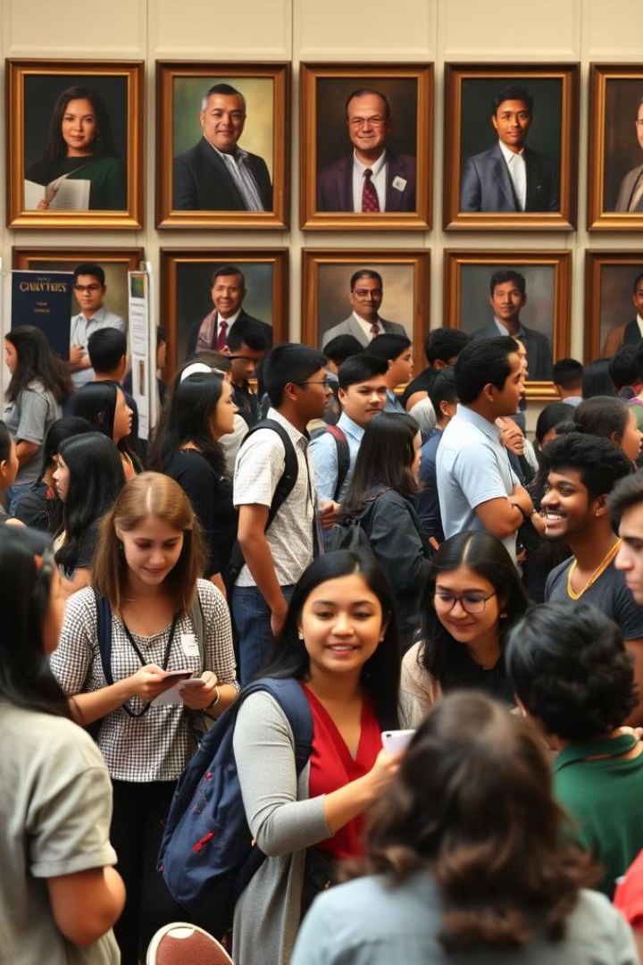
Preparing for the Future
Grooming Leaders for Tomorrow
1
Leadership Skills
Emphasis on leadership skills and independence
2
College & Career
College counseling and career guidance
3
Alumni Success
Alumni success stories and placements in top universities

